Slide 1


Final Year Project
Body Boost
Supervised By: Mr. Muhammad Usman Karim(Lecturer)

Slide 2
Project Team
Muhammad Ali Hamza (12826)
Anosh Junaid (11359)
Hidayat Ullah (11939)

Slide 3
Table of Content
Background and Introduction
Literature Review
Problem Statement
Project Scope
Proposed Solution
Requirements Summary
Design Summary
Methodology
Implementation Summary
Experiments and Results Summary
Testing Summary
Conclusion and Outlook

Slide 4
BACKGROUND AND INTRODUCTION

Slide 5
Introduction
BodyBoost is an application based on fitness
It provide users with workout and diet plans designed according to their emotional state.
It takes care of both physical and mental state.
By integrating social media textual data, the system captures real-time sentiments, enabling personalized workout and diet plans aligned with users' emotional states expressed.
Utilize technology to enhance the overall fitness journey, promoting holistic well-being.

Slide 6
BACKGROUND
Many fitness apps focus only on exercise and diet, forgetting about how people feel.
They provided workout routines and meal plans without understanding how users were feeling.
BodyBoost was made to help with this. It's not just about exercise it about how you mentally feel.
It looks at your social media to understand your emotions. Then, it suggests workouts and meals to match how you're feeling.

Slide 7
Literature Review

Slide 8
Literature Review
Studies showed that a variety of researchers from across the globe are working on sentimental analysis, health and fitness but very little work has been done on fitness app which takes user mental health and suggest workout plan and diet.
Fitbit, MyFitnessPal , Nike Training Club , 7 Minute Workout
Strengths: These application gives a wide ranges of trackers that monitors various activities.
Weaknesses: Lack of information of the user mental health lead it to the lack of wellbeing of the user.
Some advance features behind a premium feature, which may prevent budget conscious user.

Slide 9
Summary Table (1/2)
No. | Author Name | Language | Year | Methods | Data Description | Performance
1 | Muhammet Sinan Başarslan, Fatih Kayaalp | English | 2020 | NB, SVM & ANN | 4500 Twitter records of IMDB Movies & health-related twitter data | 0.85 Accuracy
2 | Facebook AL & | English | 2019 | RoBERTa and BERT | 154 million tweets | 90.2%,

Slide 10
Summary Table (2/2)
No. | Author Name | Language | Year | Methods | Data Description | Performance
3 | Sunir Gohil, Sabine Vuik and Ara Darzi | English | 2018 | SVM , SVM, NB & k-NN | 12 papers were compared | 46% (92/2) of health-based tweets contain some form of positive or negative sentiment.
[1] Basarslan, M. S., & Kayaalp, F. (2020). Sentiment analysis with machine learning methods on social media
[2] Facebook AL. (2019). RoBERTa and BERT. English. 160GB of text. SQuAD 94.6/89.4, 88.5 on the GLUE benchmark https://github.com/facebookresearch/fairseq
[3] Gandhi, A., Adhvaryu, K., Poria, S., Cambria, E., & Hussain, A. (2023). Multimodal sentiment analysis:
A systematic review of history, datasets, multimodal fusion methods, applications, challenges and future directions. Information Fusion, 91, 424-444.

Slide 11
PROBLEM STATEMENT

Slide 12
Problem Statement
Lack of Emotional Integration in Fitness Apps: Due to limited emotional support many fitness apps mainly focus on physical exercises and diet plan but lack features addressing user’s emotional state. Users might feel a gap in the support provided.[1]
Exercises and diet plan cannot be same for depress person and active person which leading to reduced app utilization and potentially hindering their fitness progress.
[1] Noetel, M., Sanders, T., Gallardo-Gómez, D., Taylor, P., Del Pozo Cruz, B., van den Hoek, D., Smith, J. J., Mahoney, J., Spathis, J., Moresi, M., Pagano, R., Pagano, L., Vasconcellos, R., Arnott, H., Varley, B., Parker, P., Biddle, S., & Lonsdale, C. (2024). Effect of exercise for depression: systematic review and network meta-analysis of randomised controlled trials. BMJ (Clinical research ed.), 384, e075847. https://doi.org/10.1136/bmj-2023-075847

Slide 13
ENDEAVOUR

Slide 14
Endeavour
Names | Roles
Anosh Junaid | Front-end, Back-end ,Documentation
Muhammad Ali Hamza | Model-Train, Back-end, Documentation
Hidayat Karim | Front-end, Documentation

Slide 15
PROPOSED SOLUTION

Slide 16
Proposed Solution
Create a fitness app that understands how users feel.
Tailor exercise plans and food suggestions based on how users are feeling emotionally.
For people feeling down or stressed, suggest calming exercises that can boost mood.
For people feeling energetic and motivated, recommend more intense workouts and healthy meals.
Make the app more supportive by adding features that help users feel better emotionally, making it a complete fitness solution.

Slide 17
Requirements Summary
Our project has two users:
User/Trainee
Admin
Use Cases : 12
Functional Requirements: 12

Slide 18
Design Summary
BodyBoost is designed to take a both physical and mental health approach to fitness, recognizing that physical and mental well-being are interconnected. By providing personalized workout and diet plans based on users' emotional states, the app aims to support users in achieving overall health.
BodyBoost integrates real-time sentiment analysis from users' social media posts. This enables the app to understand users' emotional states and recommend appropriate exercises and meals tailored to their feelings.
Unlike traditional fitness apps that primarily focus on physical exercises and diet plans, BodyBoost prioritizes emotional well-being.

Slide 19
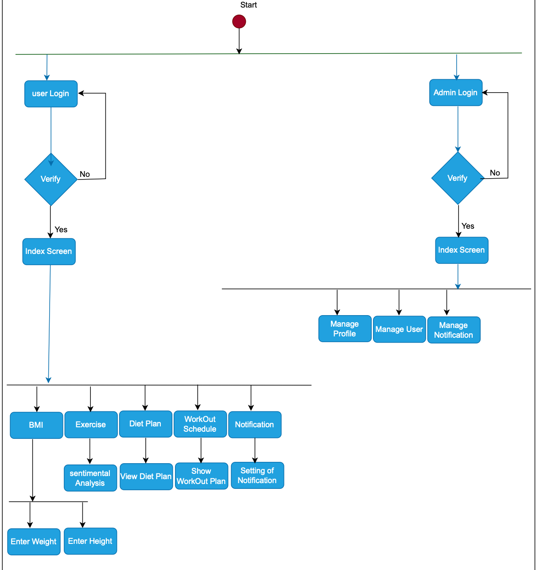
Methodology (1/3)

Slide 20
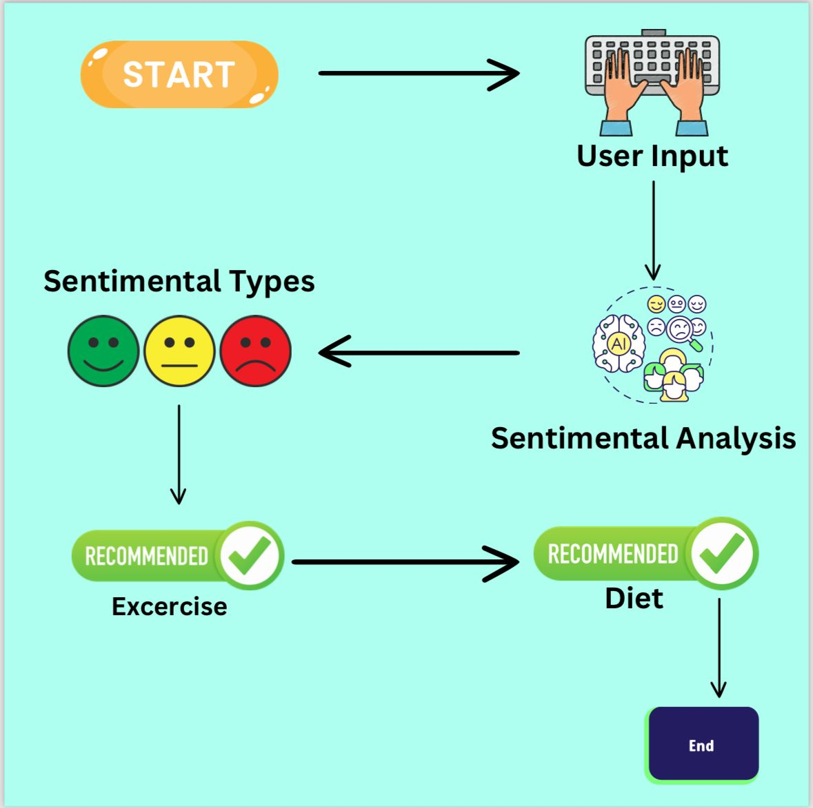
Methodology (2/3)

Slide 21
Methodology (3/3)
The user provides their login credentials, and the system verifies them. Once verified, the user is redirected to the main screen (Index Screen), which offers functionalities like BMI, Exercise, and Diet Plan.
The user can access various features through the main screen, including functionalities like Workout Schedule and Workout Tracking (Manage Functionalities), as well as Admin Functionalities such as Manage Profile, Manage Notification, and Setting of Notification.
In the context of above diagram, these points cover the major features and functionalities of the system.

Slide 22
Implementation Summary
The implementation of body boost began with gathering a diverse dataset of tweets, caption followed by training a Naïve baye model to understand emotional states.
We’ve also opted to utilize the RoBERTa model for sentiment analysis due to its superior performance compared to the Naive Bayes approach.
Integrated sentiment analysis model into the fitness app for personalized exercise suggestions.
Conducted research to enhance exercise recommendation system.

Slide 23
Results Summary (1/2)
The Naive Bayes model achieved an accuracy of 0.74 in sentiment analysis.
RoBERTa model on the MNLI dataset is 90.2%
RoBERTa is trained on a much larger dataset of 154 million[2] tweets , including existing unannotated NLP datasets and a new set called CC-News, derived from public news articles.
[2] Loureiro, D., Rezaee, K., Riahi, T., Barbieri, F., Neves, L., Anke, L. E., & Camacho-Collados, J. (2023). Tweet insights: a visualization platform to extract temporal insights from twitter. arXiv preprint arXiv:2308.02142. https://github.com/facebookresearch/fairseq

Slide 24
Results Summary (2/2)
On the GLUE benchmark (General Language Understanding Evaluation), RoBERTa achieves an overall score of 88.5, demonstrating its effectiveness in various NLP tasks.
The GLUE leader board ranks models participating in the benchmark, evaluating their general language understanding capabilities.[3]
RoBERTa also matches state-of-the-art results on the SQuAD (Stanford Question Answering Dataset), which assesses computer systems' ability to understand and answer questions based on text passages.
[3] Liu, Y., Ott, M., Goyal, N., Du, J., Joshi, M., Chen, D., ... & Stoyanov, V. (2019). Roberta: A robustly optimized bert pretraining approach.arXiv preprint arXiv:1907.11692.
[

Slide 25
Testing Summary
Through our testing efforts, we aimed to enhance the reliability and functionality of the BodyBoost platform ensuring a seamless user experience across all key features.
Testing was performed to validate users' ability to analyse sentiment accurately using correct input.
Through our testing efforts, we aimed to enhance the reliability and functionality of the BodyBoost platform, ensuring a seamless user experience across all key features.
we focused on enhancing the functionality and accuracy of the BodyBoost platform's key feature sentimental analysis.
For Naïve baye trained algorithm we gathered approximately 20,000 tweet dataset to train a model to predict the sentiments of text more effectively.

Slide 26
CONCLUSION AND OUTLOOK

Slide 27
Conclusion & Outlook (1/2)
Our project demonstrates the potential of sentiment analysis models like Naive Bayes and RoBERTa in tailoring exercise suggestions based on users' emotional states.
We want to make it even better by adding social media so we can see how people are feeling right away.
We'll work with fitness experts to make sure our suggestions are good for everyone.
Everyone should be able to use our app, so we'll make sure it's easy for everyone.

Slide 28
Conclusion & Outlook (2/2)
We'll make the app more fun by adding games and challenges for everyone to enjoy.
Our app is just the beginning of helping people feel better both physically and emotionally.
Our big dream is to help everyone get healthier and happier using AI and different ideas.

